Slide 1
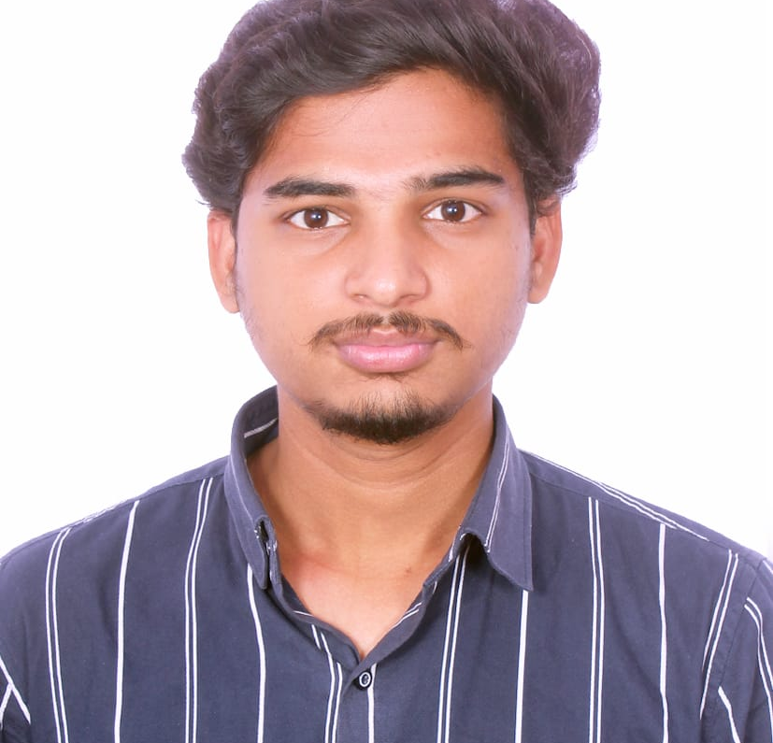


GOUTHAM D
Analyst/Software Engineer
Bachelor In Mechanical Engineering:
2017 - 2021
Skilss
Manual Testing
Automation Testing
Java
SQL
Additional Details
Communication Skills
Team management
Bengaluru
GOUTHAM.DESABOYINA@CAPGEMINI.COM
+91 9346328734
A4
Software Engineer who is Strong in Manual Testing and Automation Testing with intuitive problem-solving skills. Passionate about implementing and launching new projects.
Hands on experience on Testing the applications of Facebook & Zomato Login modules.
Currently working as Test Engineer For Maatr Project
Experience on writing test cases for maatr.& executing the test cases by doing the manual testing.
Manual & Automation Testing Completed
Completed the full course of manual Testing and Automation Testing in Qspiders With the Completion Certificate.
Software Testing Engineer

